Slide 1

Experiences on Yang Network Models for network management and operation.
IETF 117
Samier Barguil
samier.barguil_giraldo@nokia.com
San Francisco, July 2027

Slide 2
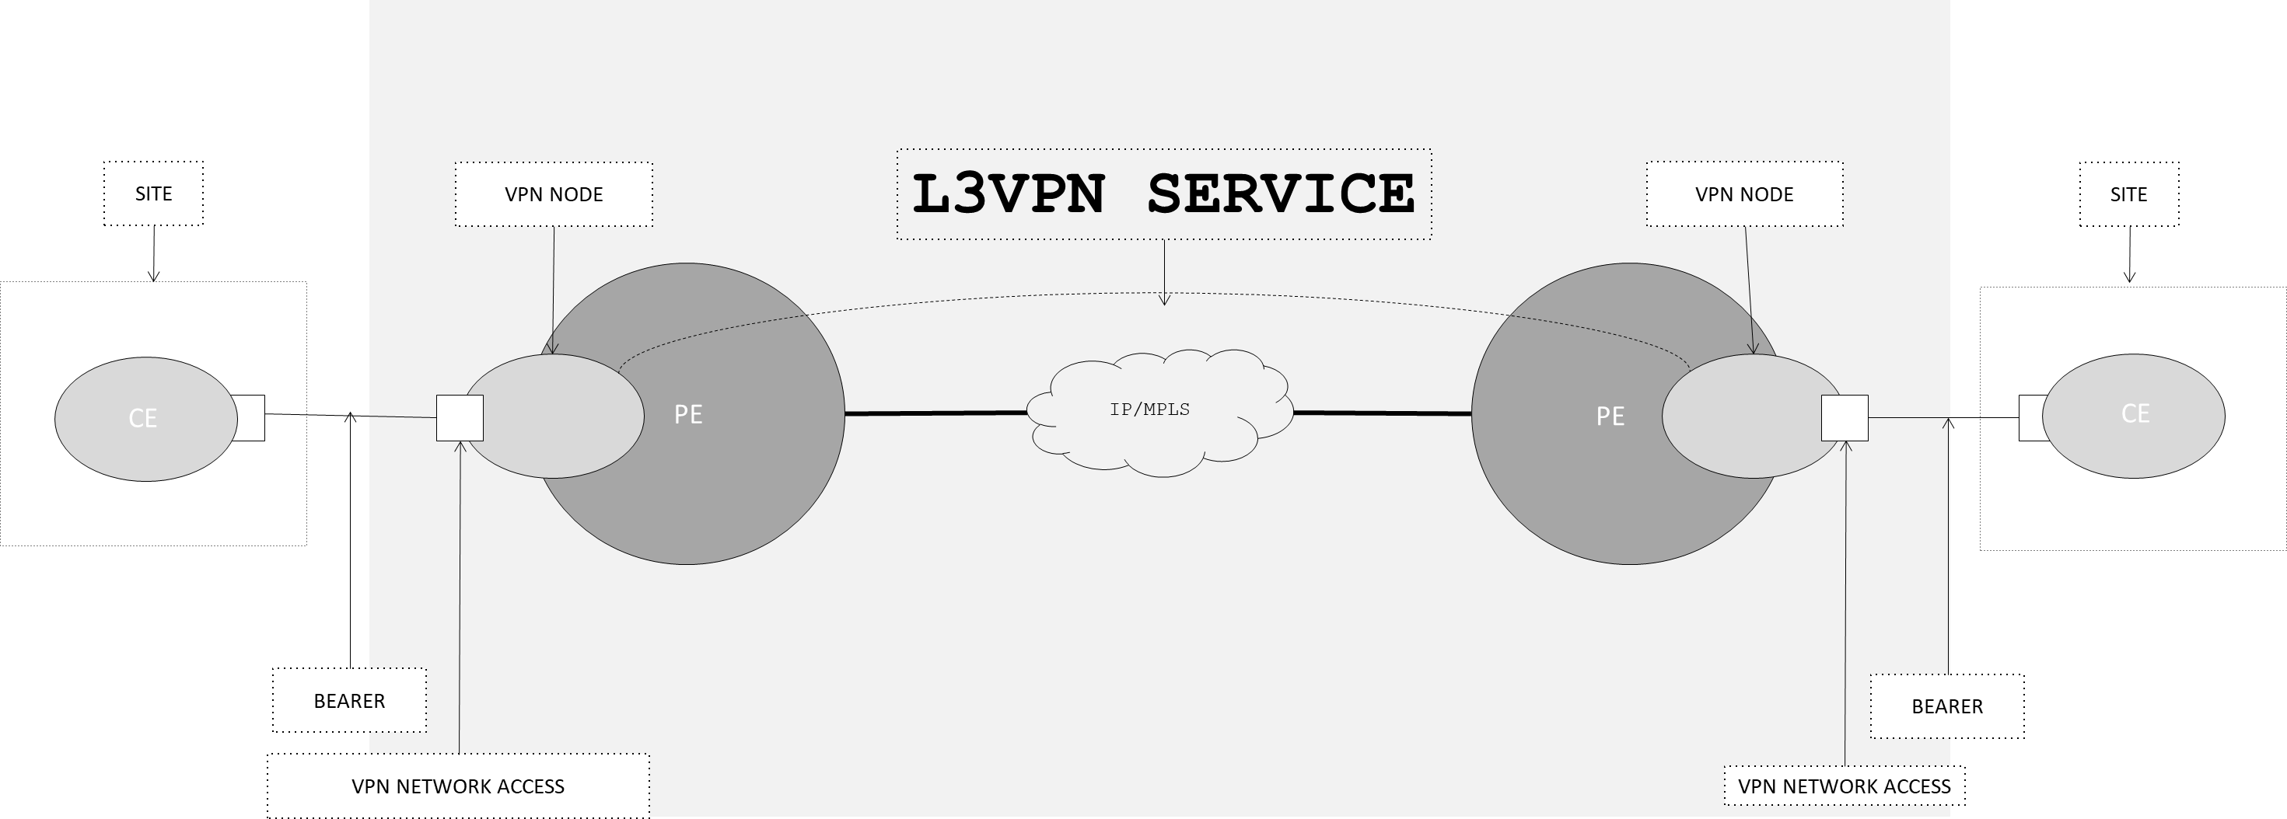
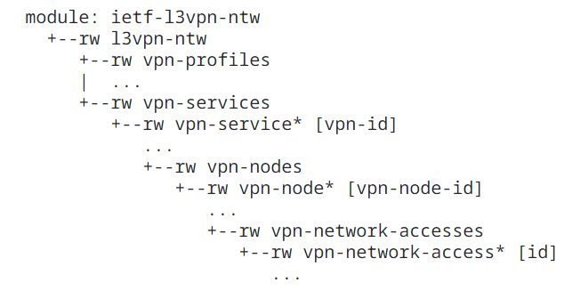
Layer 3 VPN Network Model
IETF 117 San Francisco, July 2027

Slide 3

The goods!!
COVERAGE
Includes most parameters to provision a wide set of L3VPN provision use cases.
Focused on the configuration use case.
MULTIVENDOR & ABSTRACTION
Solves part of the Multi-Vendor configuration problem. It presents a common view of the services, similar parameters and unified structure.
In a single view the service components and service topology can be inferred.
SHORT TERM ADOPTION
Several implementations has been tested in the last two years.
The feedback received has been used to improve the model and new work has been derived (Attachment Circuits, L2NM…)
Implementations:
https://github.com/IETF-OPSAWG-WG/lxnm/tree/master/Implementattion
IETF 117 San Francisco, July 2027

Slide 4

The Challenges I
IMPLEMENTATION GAPs
No matter the controller implementation not all the features/parameters available are supported.
Different version of the YANG (draft vs RFC) are supported; in some cases, the update is required generating delays.
An ecosystem is needed to make the network models fully operational.
  Without the IETF Routing Policies, IETF ACLs or IETF Key-Chain an implementation can not be reported as complete.
How to deal with network deployment rules?
  For example, the expected VRF Name should be the same in all the NEs in the network, but the VPN-Node should be unique.
    Should we use the VPN Service Name or the VPN Node name?
IETF 117 San Francisco, July 2027

Slide 5
The Challenges II
DEFINITION GAPs
There is no pointer to attach the ACLs/Forwarding policies into the VPN.
There is some GAPs in protocols behavior or definitions, for example: BGP redistribution or BGP Peering.
Notification management. Should we rely only on the RESTCONF definition or should the RFCs define expected behavior.
  Some models define custom RPCs or Notifications.
OPERATIONAL GAPs
How to validate if the service is really configured in the network?
  How the VPN service Operational Status is related with the VPN node Operational status or the VPN Network access.
How to fully describe the logic of an implementation?
  The Network Model includes a subset of the parameters available in the device model.
  Not all the parameters follow a 1:1 mapping relationship.
  How can be possible to compare/query two implementations using an automation.
San Francisco, July 2027

Slide 6
Experiences on Yang Network Models for network management and operation.
IETF 117
Samier Barguil
samier.barguil_giraldo@nokia.com
San Francisco, July 2027

Slide 7
Thanks

